Slide 1

IMAGE PLAYER
Software Systems Development
Mentor : Prof. Charu Sharma
Group 26
Aakash Tripathi 2022201053
Santanu Biswas 2022201031
Sumonto Chatterjee 2022201028
Utkarsh Pathak 2022201018

Slide 2
INTRODUCTION - IDEA
We have developed a tool which uses image and video processing to achieve various functionalities, such as basic photo editing, applying preset image filters and also real time video filters.
The tool is implemented as a web application and is meant to be quick and handy for users to get the impressive results on the go. Real time video filters range from putting sunglasses on your face to a top hat on your head, to making users appear much older with a mustache and so on.

Slide 3








TECHNOLOGY STACK
Front End
Back End

Slide 4
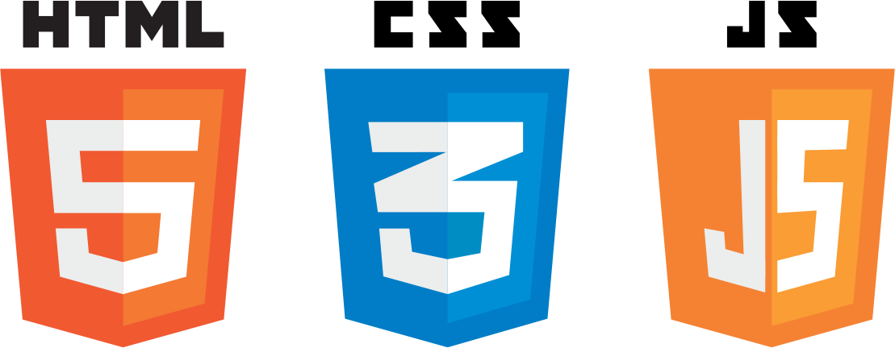
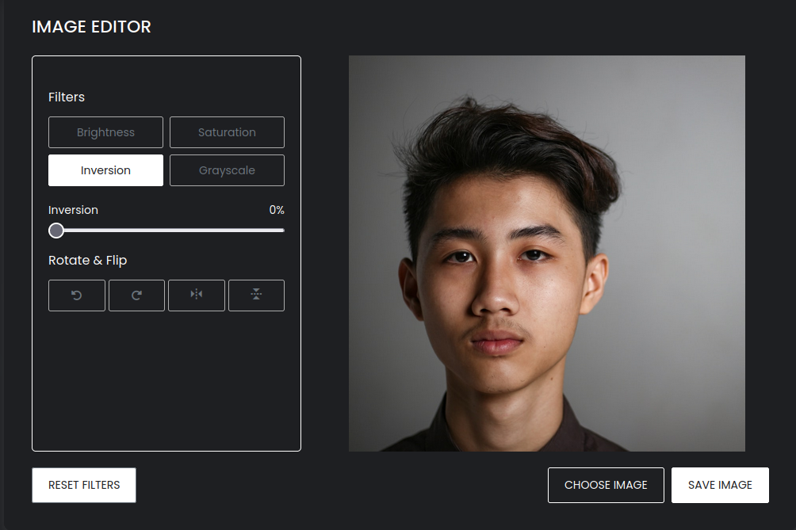
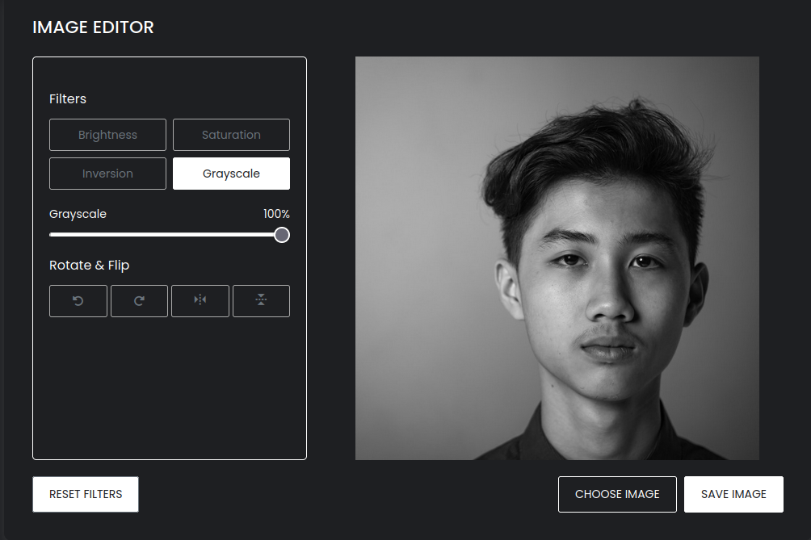
FRONT END
Created a UI using html/css and javascript which has three different modules in it. Module 1 is about basic photo editing, module 2 is about Image filters and module 3 is where you can play around with cool video filters.
Users can also download the modified image or reset the filters applied to its default value.

Slide 5
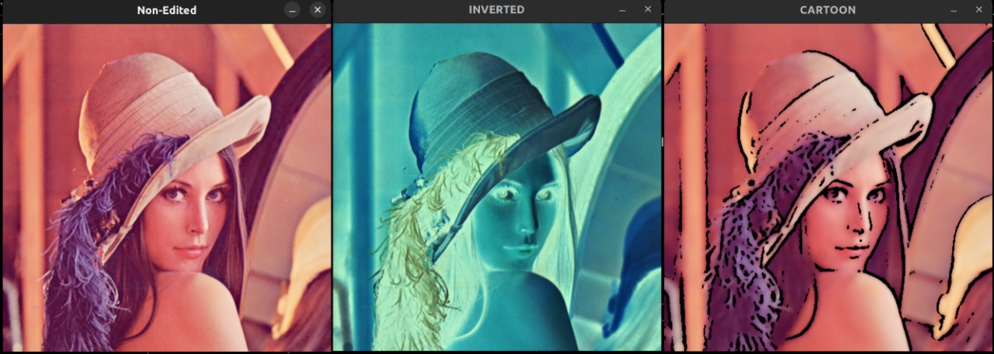
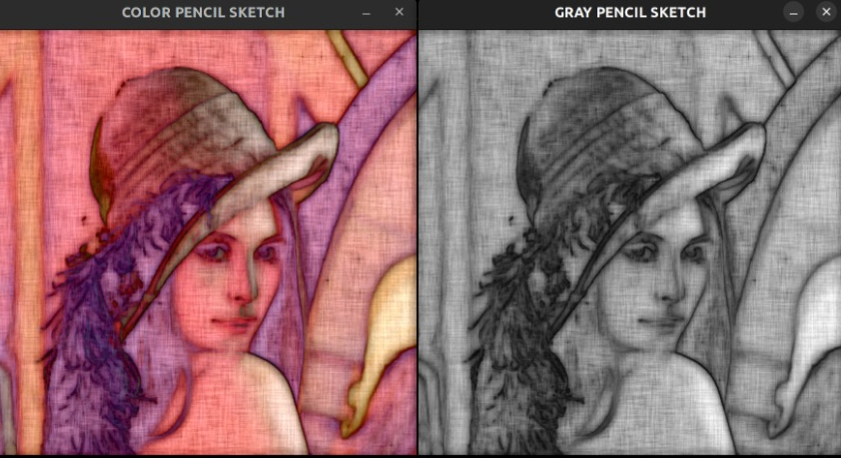
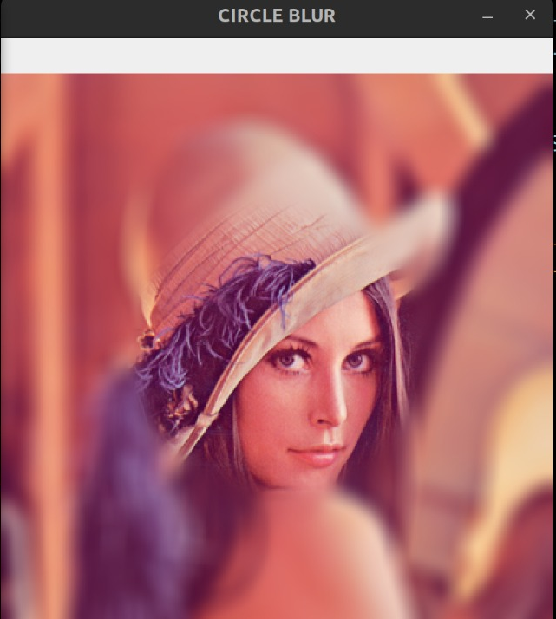
BACK END
The back end is developed using python and web framework Flask. We are using OpenCV, which is a open source computer vision and machine learning software library, for larger part of image and video processing and making the image filters along with lightweight image processing libraries such as Pillow and other libraries like cvzone, numpy etc.

Slide 6
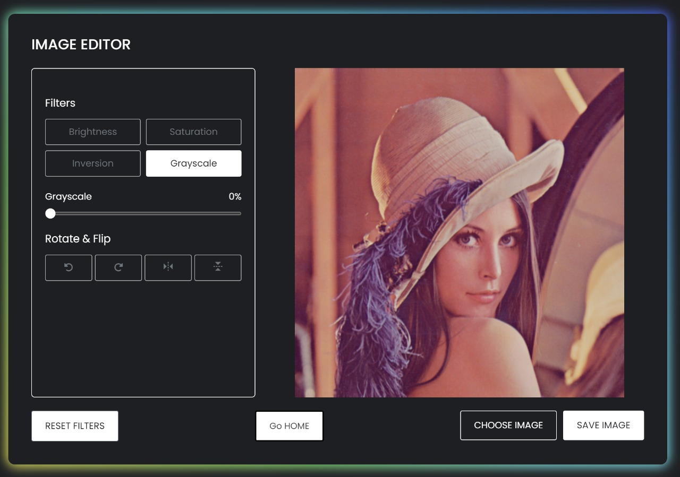
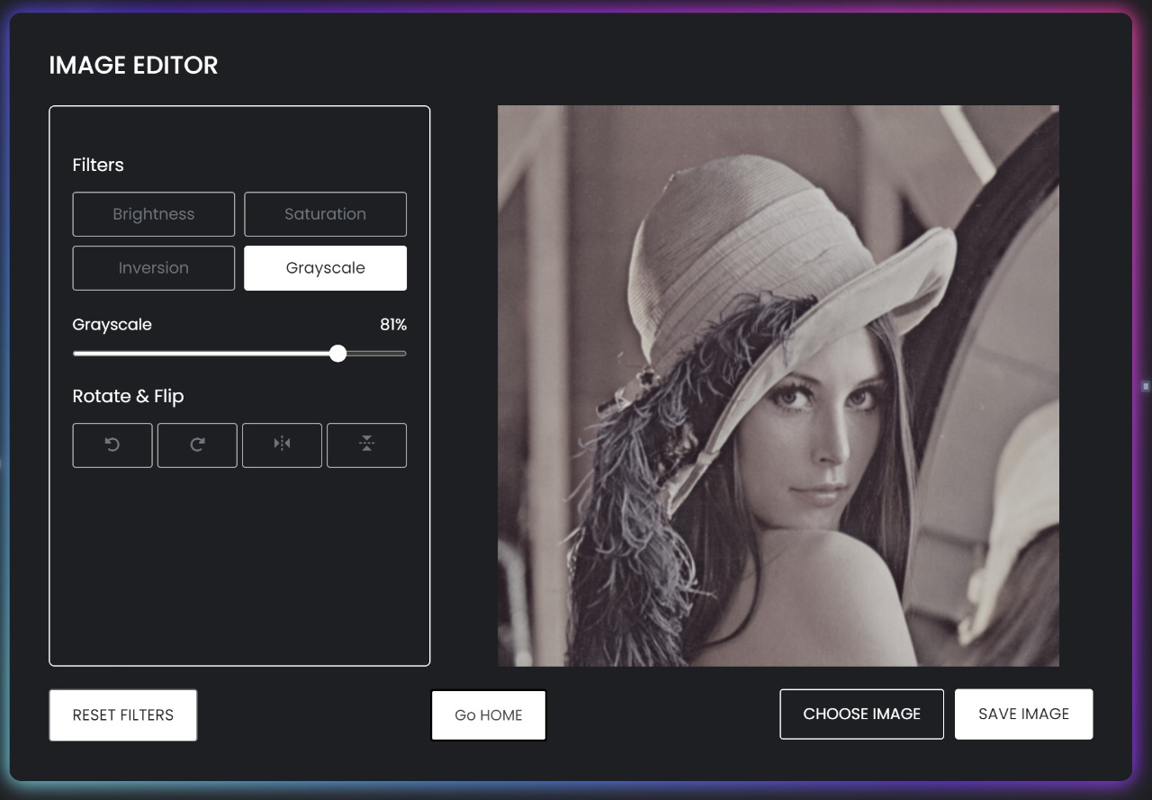
Module 1 - Lightweight Photo Editing
Module 1 is all about applying lightweight editing to images, such as manipulating brightness/contrast and inverting an image.
All this functionalities are implemented using Javascript and the real time preview of the image can be seen in the frontend window and can also be downloaded.

Slide 7
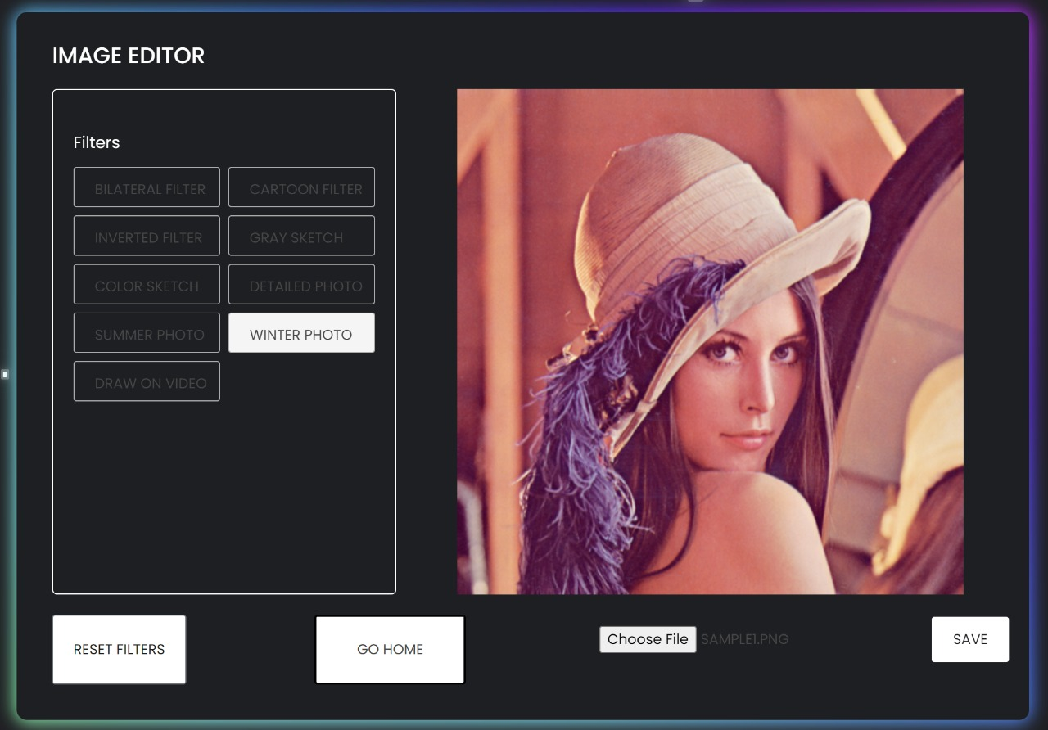
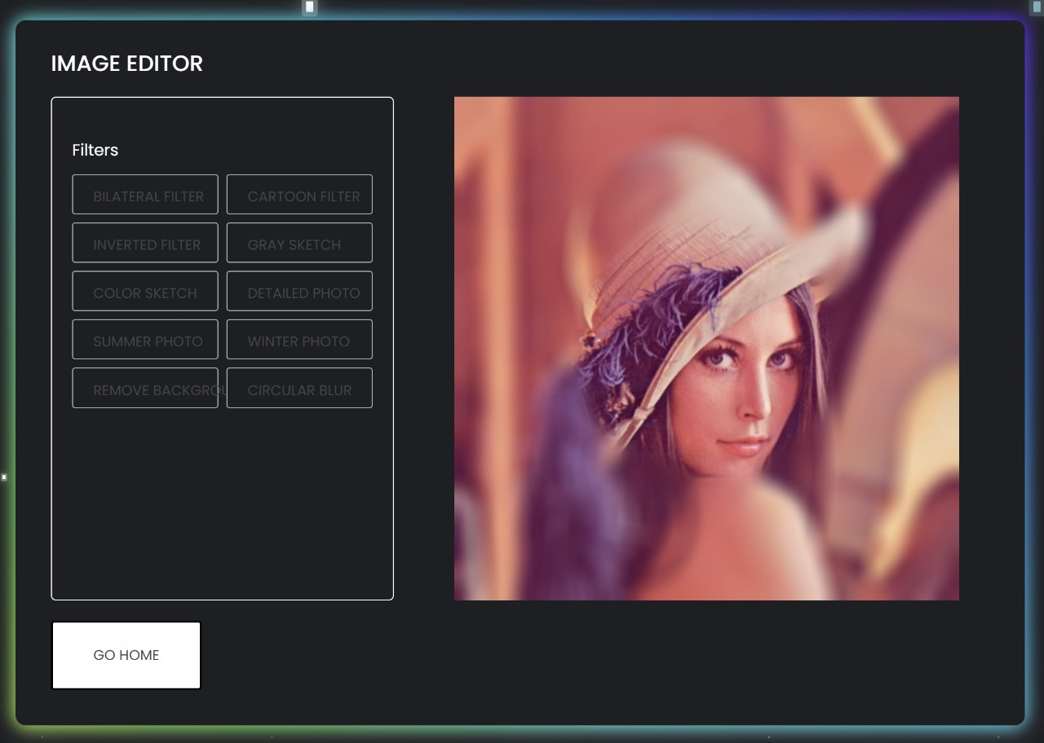
Module 2 - Image Filters
Module 2 is about changing the appearance of an image by altering the colors of the pixels. Manipulating the contrast as well as adding a variety of special effects to images are some of the results of applying filters.
User can enhance images with ease using a range of photo filters and photo effects to choose from.

Slide 8
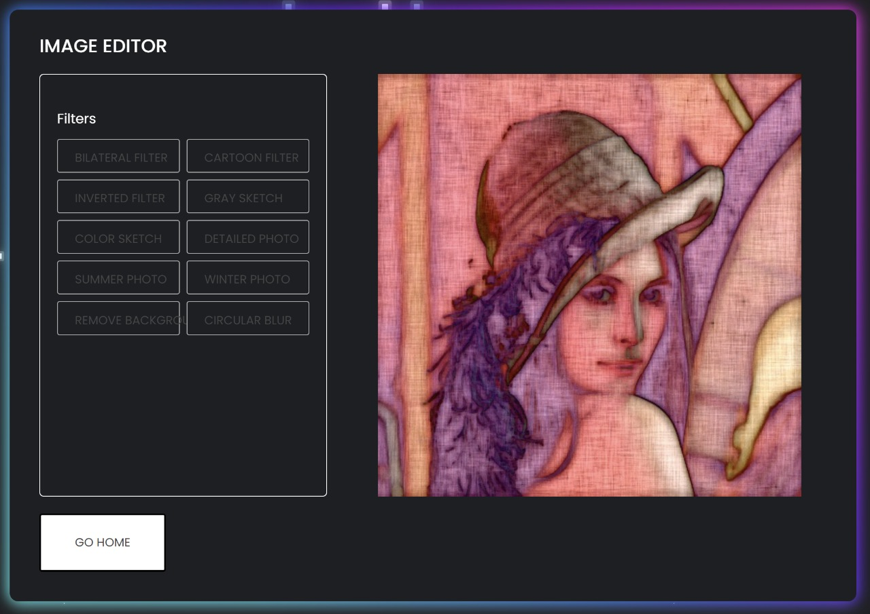
Module 2 - Image Filters
To achieve great results we have used OpenCV and other frameworks like CVZone which are powerful open-source libraries for the computer vision and image processing.
All image filters are implemented as a separate python method.
After obtaining a image it is passed to the desired filter method, which then, using all the functionalities provided by the above frameworks produces the final image.

Slide 9
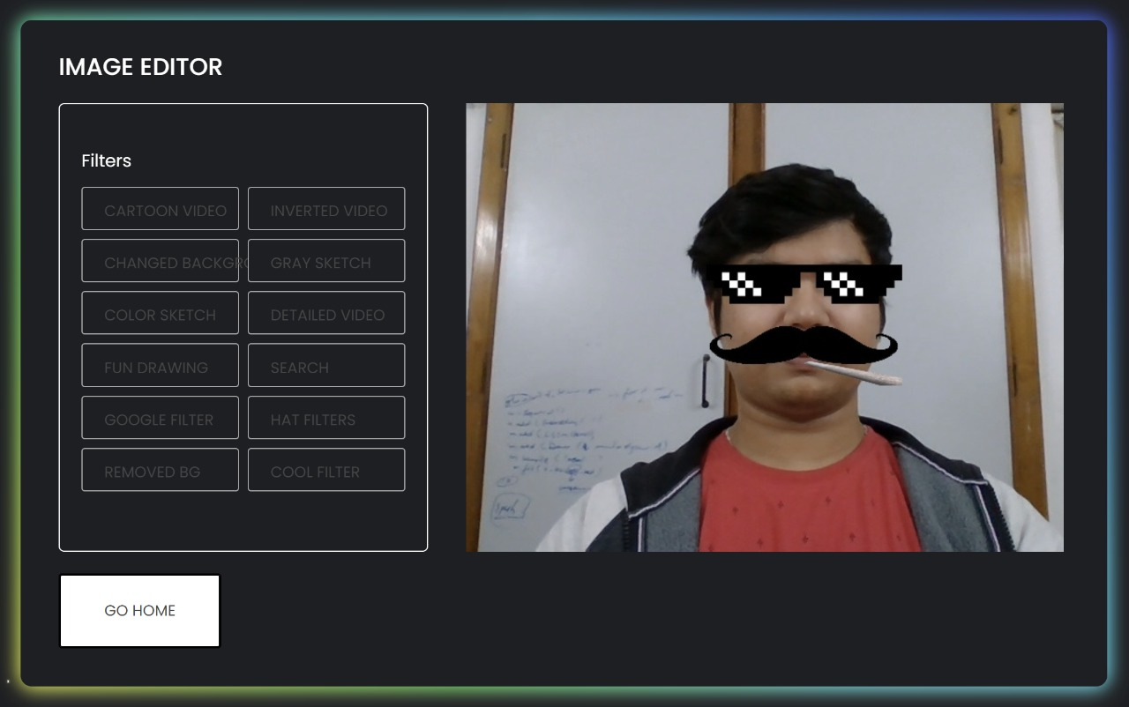
Module 3 - Real Time Video Filters
Real time video filters are the effects that you can add to your video and then take a snap of it. It ranges from putting sunglasses on your face to a top hat on your head, to making users appear much older with a mustache and so on.
We capture individual frames from the user’s webcam and then apply filters on the individual frames and render them on the screen. This process happens so quickly that it results in a smooth filter effect.

Slide 10
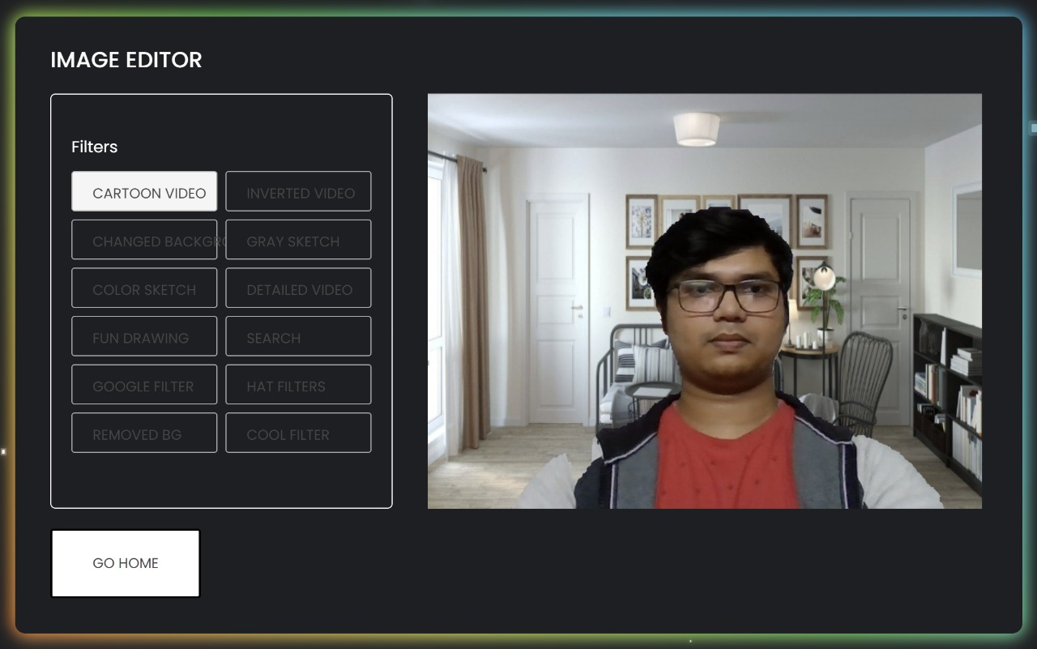
Module 3 - Real Time Background Replacement
For many reasons, the background of the video needs to be modified as there are so many other interruptions in the background.
So we used haarcascade classifier, which is a pre-trained model , to distinguish between foreground and background and then replace them with the desired content.

Slide 11
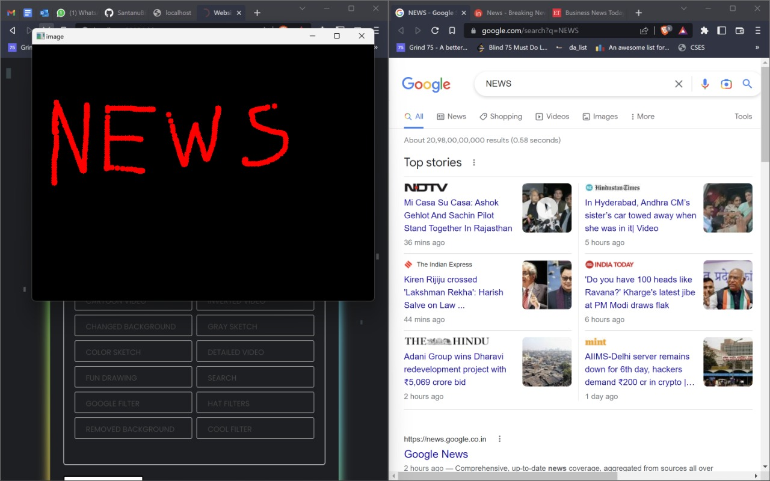
Module 3 - Real Time Text Extraction
Text recognition has gained a lot of prominence in recent years as it has entered into a large arena of applications such as in automatic reading of license plate, signboards, etc.
We have implemented the same wherein we extract a handwritten text from a image and then list down the google search results of the text in a separate tab.

Slide 12
FUTURE SCOPE
Our aim so far has been building a lightweight image editing online tool, But this basic implementation can be enhanced and enriched with a wide variety of functionalities such as more filters to choose from, using ML to make innovative and creative filters and other advanced image modifications.
The performance and accuracy of the video features such as real-time air writing on a video, adding snapchat filters, text recognition can be improved with more testing.
Summing all, this project can be turned into a very functional and fun tool available online for anyone who wants to do something creative.

Slide 13
THANK YOU

